Slide 1
GenAI Curriculum Generator
VALAVALA. SRI MAHA LAKSHMI BHAVAGANYA
BODDEPALLI LAKSHMI SURYA TEJA
BOMMAKANTI SRI LAKSHMI PRASANNA
CHIKKAM SURESH
KOTA SHAILU

Slide 2

The Problem We’re Solving
GenAI Curriculum Generator
GenAI Curriculum Generator is an intelligent curriculum design platform that leverages IBM's Granite 3.3 2B AI model (via Ollama) to provide comprehensive educational curriculum generation and planning recommendations. The platform addresses the challenge of accurate curriculum design by delivering AI-powered insights, detailed course structures, topic recommendations, and semester-wise syllabi.

Slide 3

What We Offer Through AI
Generates topics, projects, learning outcomes & tools list
Supports educators, institutions & training platforms
Produces ready-to-share professional syllabus output (PDF)
Automatically builds complete academic curriculum using Generative AI
Converts simple user inputs into structured semester-wise programs
Aligns courses with real industry requirements
Reduces curriculum design time from weeks → minutes

Slide 4
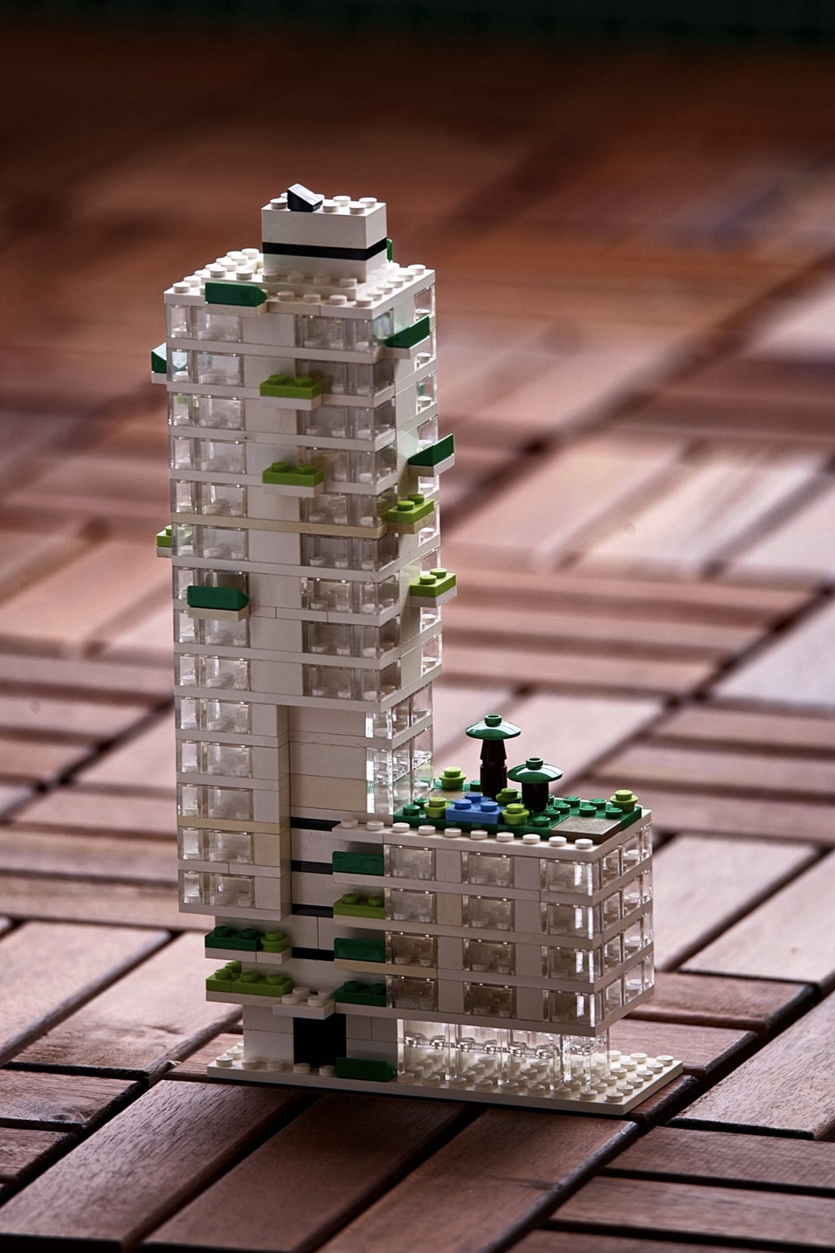
How Our AI Engine Builds Curriculum
User submits academic requirements through the web interface
Input parameters include skill domain, level, duration, semesters, and industry focus
System constructs a structured prompt template automatically
Generative AI model processes the prompt and produces curriculum content
Output is organized into overview, semester plans, tools, and outcomes
Results are formatted into structured visual layout
Curriculum can be exported as a professional PDF document
User Input → AI Engine → Curriculum Generation → Formatted Output → PDF Download

Slide 5

Technology Stack & Tools Used
Backend service layer implemented using Python web framework
REST-based API endpoints for curriculum generation and export
Generative AI integration for automated syllabus creation
Local LLM execution environment for low-latency responses
Structured prompt engineering for standardized academic outputs
Template-based frontend rendering for dynamic content display
Automated PDF generation module for downloadable syllabus reports
Modular and extensible system architecture design

Slide 6

System Architecture Overview
Frontend Layer
Backend Layer
Interactive UI built using Flask templates
Dynamic input forms with validation
Real-time loading & generation feedback
Structured curriculum output display
REST-style API architecture
Prompt builder engine
Curriculum parsing & formatting module
PDF generation service
AI Engine
Output Services
Local LLM integration via Ollama
Granite 3.3 (2B) model
Custom prompt engineering
Structured output enforcement
Curriculum formatting engine
Semester-wise table generation
PDF export module

Slide 7

🚀 Real-World Impact
Helps universities design industry-aligned curricula instantly
Supports educators with ready-to-use structured course plans
Enables students to access custom learning roadmaps
Reduces manual academic planning effort by 80–90%
Bridges the gap between education and industry needs
Can be adopted by colleges, training institutes, and EdTech platforms
Scales easily across domains like AI, Data Science, Cybersecurity, Cloud, etc.

Slide 8
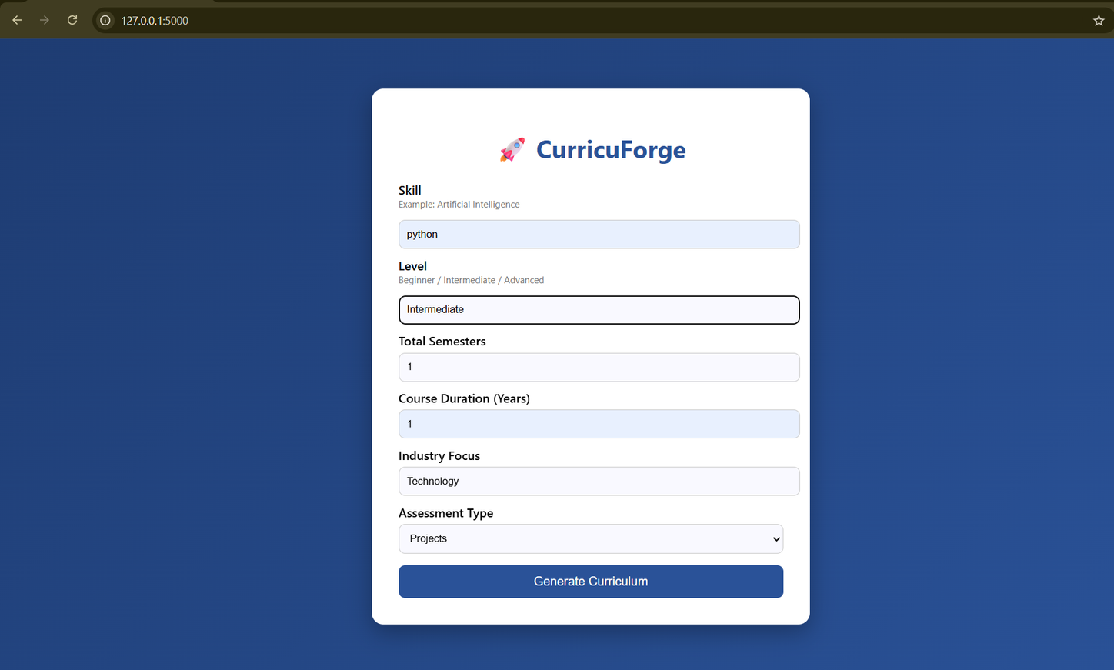
INPUT INTERFACE

Slide 9
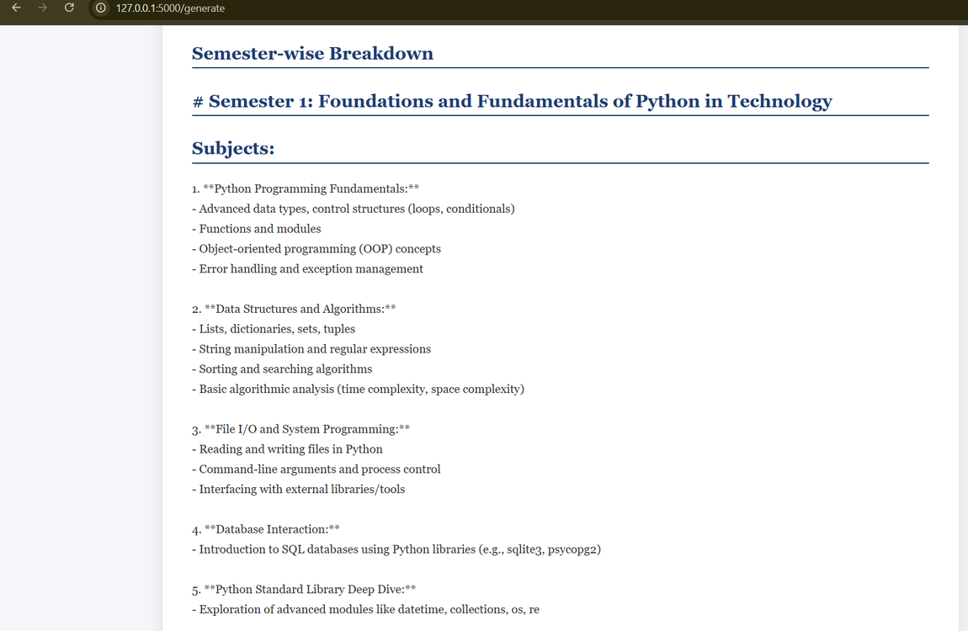
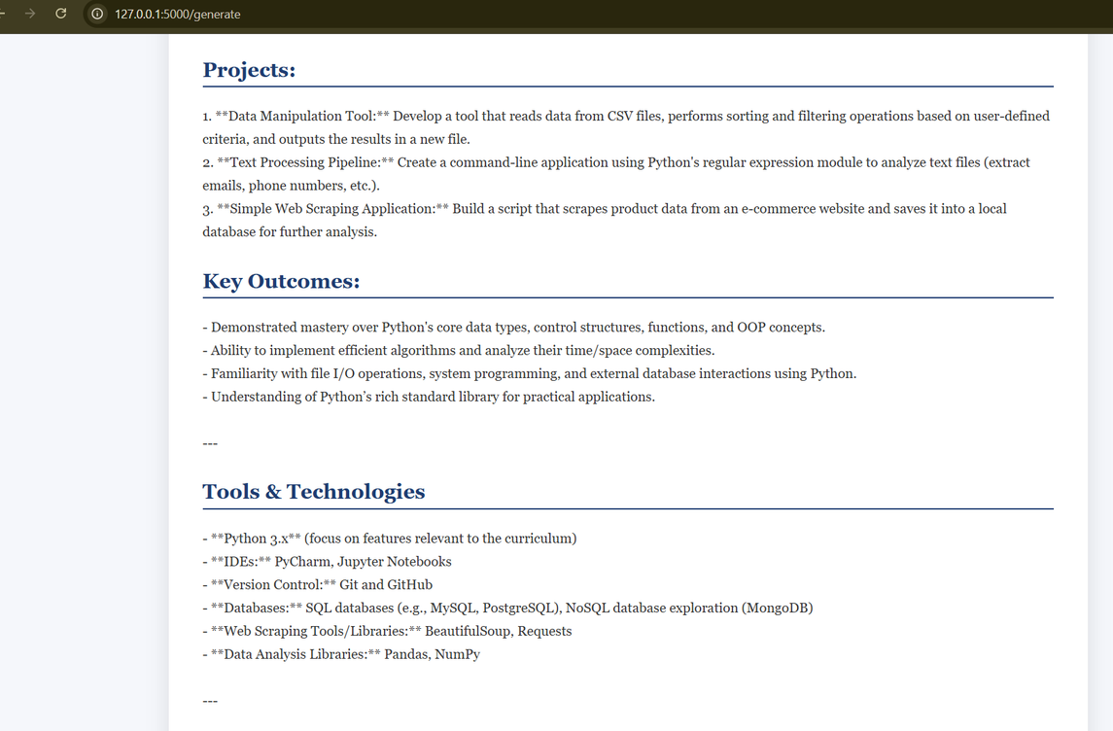
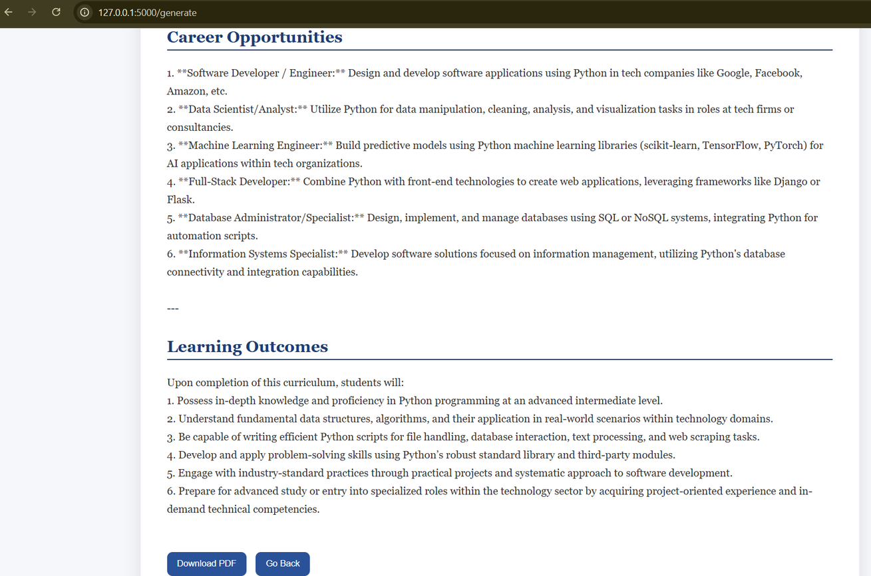
OUTPUT INTERFACE

Slide 10
Thankyou

